Slide 1
Arrays

Slide 2
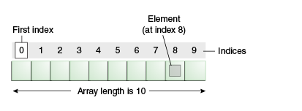
Arrays
Array is a collection of group of similar data types
Arrays are used to store multiple values in a single variable, instead of declaring separate variables for each value.
Array in java is index-based, the first element of the array is stored at the 0 index.

Slide 3
Advantages
Code Optimization: It makes the code optimized, we can retrieve or sort the data efficiently.
Random access: We can get any data located at an index position.
Disadvantages
Size Limit: We can store only the fixed size of elements in the array. It doesn't grow its size at runtime.
To solve this problem, collection framework is used in Java which grows automatically.

Slide 4
4 Steps to use arrays in java
Declaring an Array
Creating an array/giving memory
Initializing the array
Using an array/ accessing the array

Slide 5
1. Declaring an Array
class Demo
{
public static void main(String args[])
{
int[] arr;
int []arr;
int arr[];
int[] arr1,arr2,arr3;
}
}
dataType[] arr;
dataType []arr;
dataType arr[];
dataType[] arr1,arr2,arr3;
Example
int[] arr;
int []arr;
int arr[];
int[] arr1,arr2,arr3;

Slide 6
2. Creating an array and giving memory or instantiating array
class Demo
{
public static void main(String args[])
{
int[] arr;
arr=new int[10];
int[] arr=new int[10];
}
}
Array is an object
It has to created using new operator
Example
int arr[]=new int[10];
Declaring and instantiating in single line

Slide 7
3. Initializing the array
import java.util.Scanner;
class Demo
{
public static void main(String args[])
{
Scanner obj=new Scanner(System.in);
int arr[];
arr=new int[10];
for(int i=1;i<arr.length;i++)
{
arr[i]=obj.nextInt();
}
}
}
class Demo
{
public static void main(String args[])
{
int a[]={33,3,4,5};
}
}
Declaring ,instantiating and initializing in single line

Slide 8
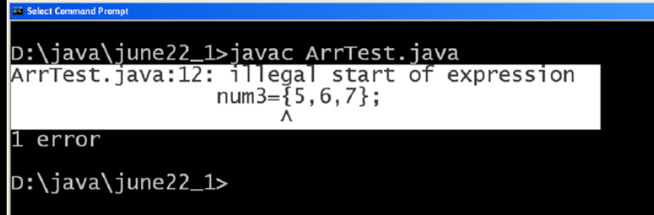
3. Initializing the array
class Demo
{
public static void main(String args[])
{
int[] num3;
num3={3,4,5,6};
}
}
class Demo
{
public static void main(String args[])
{
int[] num3;
num3=new int[]{3,4,5,6};
}
}
Not a valid statement

Slide 9
4. Accessing the elements
class Demo
{
public static void main(String args[])
{
int[] num3;
num3=new int[]{3,4,5,6};
for(int i=0;i<num3.length;i++)
{
System.out.println(num3[i]);
}
}
}

Slide 10
Write a Java program to read n elements and display n elements using array?
Exercise-1

Slide 11
import java.util.*;
class ArrayDemo
{
public static void main(String args[])
{
int n;
System.out.println("Enter the size");
Scanner sc=new Scanner(System.in);
n=sc.nextInt();
int arr[]=new int[n];
System.out.println("Enter Elements");
for(int i=0;i<n;i++)
{
arr[i]=sc.nextInt();
}
System.out.println("Elements in Array");
for(int i=0;i<n;i++)
{
System.out.println(arr[i]);
}
}
}

Slide 12
Processing Arrays
When processing array elements, we often use either for loop or foreach loop because all of the elements in an array are of the same type and the size of the array is known.
Example: printing , summing and find the largest element in the array
public class TestArray
{
public static void main(String[] args)
{
//declaring and creating arry ,myList is the reference variable i. e array name
double[] myList = {1.9, 2.9, 3.4, 3.5};
// Print all the array elements , myList.length gives us the number of elements in the array
for (int i = 0; i < myList.length; i++)
{
System.out.println(myList[i] + " ");
}

Slide 13
// Summing all elements
double total = 0;
for (int i = 0; i < myList.length; i++)
{
total += myList[i];
}
System.out.println("Total is " + total);
// Finding the largest element
double max = myList[0];
for (int i = 1; i < myList.length; i++)
{
if (myList[i] > max) max = myList[i];
}
System.out.println("Max is " + max);
}
}

Slide 14
The foreach Loops:
JDK 1.5 introduced a new for loop known as foreach loop or enhanced for loop, which enables you to traverse the complete array sequentially without using an index variable.
Example:
public class TestArray1
{
public static void main(String[] args)
{
double[] myList = {1.9, 2.9, 3.4, 3.5};
// Print all the array elements
for (double element: myList)
{
System.out.println(element);
}
}
}

Slide 15
Passing Arrays to Methods:
Just as you can pass primitive type values to methods,
you can also pass arrays to methods.
For example, the following method displays the elements in an int array −
Example:
public static void printArray(int[] array) //it is a method
{
for (int i = 0; i < array.length; i++)
{
System.out.print(array[i] + " ");
}
}
→You can invoke it by passing an array.
For example, the following statement invokes the printArray method to display 3, 1, 2, 6, 4, and 2 .
printArray(new int[]{3, 1, 2, 6, 4, 2});

Slide 16
Returning an Array from a Method:
A method may also return an array.
For example, the following method returns an array that is the reversal of another array −
Example:
public static int[] reverse(int[] list)
{
int[] result = new int[list.length];
for (int i = 0, j = result.length - 1; i < list.length; i++, j--)
{
result[j] = list[i];
}
return result;
}

Slide 17
What is 2-D Array?
Array of Arrays.
2-D array usually represented with rows and columns

Slide 18
2-D Array Declaration
We can declare 2-D array in following ways type[][] referencevariable;
or
type referencevariable[][]; For example:
int marks[][];
Each element in the 2-D Array must be the same type.

Slide 19
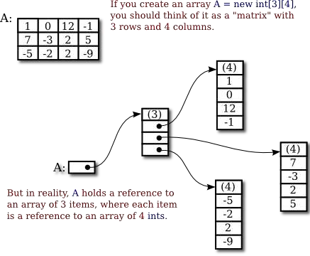
Creation of 2-D Array
arrayreferencevariable = new type[value][value];
For example :
marks = new int[3][4];

Slide 20
More on 2-D Array Creation
int marks[][] = new int[][]; // incorrect;
int marks[][] = new int[][4] // incorrect;
int marks[][] = new int[3][] // correct;

Slide 21
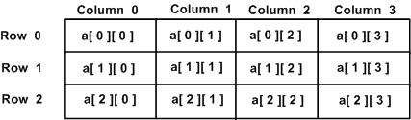
2-D array in form of rows and columns:
marks=new int[3][4];

Slide 22
Initialization of 2-D Array
After array creation we can initialize the 2-D array like this :
Arrayvariable[row][column]= value;
For example lets initialize the marks array :

Slide 23
marks[0][0]=8;
marks[0][1]=9;
marks[0][2]=10;
marks[0][3]=7;
Col 0
Col 1
Col 3
Col 4
Row 0
8 | 9 | 10 | 7
marks[1][0]=12;
marks[1][1]=21;
marks[1][2]=30;
marks[1][3]=7;
Col 0
Col 1
Col 2
Col 3
Row 1
12 | 21 | 30 | 7
marks[2][0]=31;
marks[2][1]=45;
marks[2][2]=10;
marks[2][3]=40;
Col 3
Col 0
Col 1
Col 2
Row 2
31 | 45 | 10 | 40

Slide 24
Col 2
Col 0
Col 1
Col 3
8 9 10 | 7
12 21 30 | 7
31 45 10 | 40
Row 0
Row 1
Row 2
Now if you want to access any element from 2-D array
System.Out.Println(marks[1][2]); output = 30
System.Out.Println(marks[0][0]);
output = 8

Slide 25
We can also initialize the array at the time of array creation
int[][] marks = new int{
{1,2,0,5},
{4,5,1,4},
{7,6,5,9}
}

Slide 26
How we can get array length
marks.length // tell us rows. marks[0].length // tell us columns.

Slide 27
A JAVA program to read and display two dimensional array (Matrix) in java
import java.util.Scanner;
public class Ex2DArray
{
public static void main(String args[])
{
int row, col, i, j;
int arr[][] = new int[10][10];
Scanner scan = new Scanner(System.in);
System.out.print("Enter row for the array (max 10) : ");
row = scan.nextInt();
System.out.print("Enter column for the array (max 10) : ");
col = scan.nextInt();

Slide 28
//To Read matrix elements
System.out.println("Enter " +(row*col)+ " Array Elements : ");
for(i=0; i<row; i++)
{
for(j=0; j<col; j++)
{
arr[i][j] = scan.nextInt();
}
}
//To print matrix
System.out.print("The Array is :\n");
for(i=0; i<row; i++)
{
for(j=0; j<col; j++)
{
System.out.print(arr[i][j]+ " ");
}
System.out.println();
}
}
}

Slide 29
Jagged Array (non-rectangular array)
A jagged array is an array of arrays such that member arrays can be of different sizes, i.e., we can create a 2-D array but with a variable number of columns in each row.
Example:
int[][] num = new int[5][];
num[0] = new int[1];
num[1] = new int[5];
num[2] = new int[2];
num[3] = new int[3];
So here we are defining columns explicitly.
Another Way:
int[][] num={ {1}, {1,2}, {1,2,3,4,5}, {1,2}, {1,2,3} };

Slide 30
For Accessing:
for (int i=0; i<num.length; i++ )
{
for (int j=0; j<num[i].length; j++)
System.out.println(num[i][j]);
}
Alternatively:
for (int[] a : num)
{
for (int i : a)
System.out.println(i);
}

